Slide 1

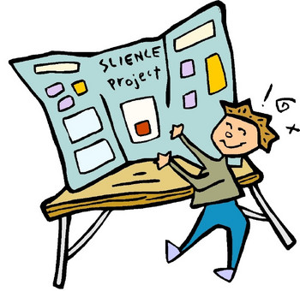

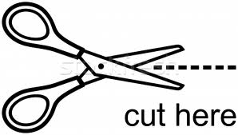
Did you know that the Scientific Name for Gorilla is
Gorilla gorilla?
Learn more at
View Ridge Science and Engineering Night!
May 11, 2017 6 -8 PM
Do a Science Project, Display, or Demo. – All ages can do this! Research something you’re interested in! Make an engineering display! Do a science project or demonstration! Work on your own, as a team, or with your family.
Do a fun science/eng hands-on activity. – Check out the many fantastic hands-on activities!
Volunteers needed!! Can you help talk with students about their science projects? Want to help set up or clean up? Email Dave at dave@affinityventuresnw.com.
Sign-up to Do a Project!
Sign up by April 26! You can sign up in two ways:
1) Fill out the online form at: https://goo.gl/forms/s60LyfyRK1G3UgJh1; OR
2) Return this form by kidmail to the office to “Science and Engineering Night.”
Student Name ____________________________________ Grade/Rm # _________
Parent email __________________________________________________________
Topic, if known _________________________________________________________
Project Display Board Needed? Circle one. (Yes/No)

Slide 2
Student Projects!
Frequently Asked Questions
Q: Do I have to do the project myself?
A: No, you can do it by yourself, with family members, or in a team.
Q: What does “student project” mean?
A: A project can be a controlled experiment, a research project, a demo, an engineering project, a scientific survey, a model, a computer program – anything related to science or engineering is okay!! Being creative is great!!
Q: What do I use to show my project?
A: We’ll have a limited supply of free poster boards that you can use, or come up with your own display!
Q: How do I get a poster board, and when will I get one?
A: You should get one within 1-2 weeks of signing up. They’ll be delivered to your classroom on Fridays, or we can arrange to have you pick it up at school.
Q: What information should be in my display?
A: Write your name, grade, and topic. Some common things people include are the question or topic you’re exploring, how you’ve done your project, and what you learned from the experiment. Include what you think is interesting, and have fun with the display!
Q: How much space will I have?
A: You’ll have a space around a 3’ height X 4’ length X 15” depth.
Q: When do I turn in my display?
A: You’ll turn in your display May 11, the day of the Science and Engineering Night. We’ll send more details when it gets closer.
Q: Do I have to do anything during Science and Engineering Night?
A: You’ll get a 20-minute time slot to be in front of your Project so people can find out more about it! Then spend the rest of the night doing other fun activities!
Q: I’m sold! How do I sign up?
A: Deadline is April 26 – All you need to do is fill out our online form at: https://goo.gl/forms/s60LyfyRK1G3UgJh1 - OR - fill in the sign-up form, and put it in kidmail.

