Slide 1
View Ridge Elementary PTA Meet & Greet
Tuesday, September 15, 7:00-8:00pm

Slide 2
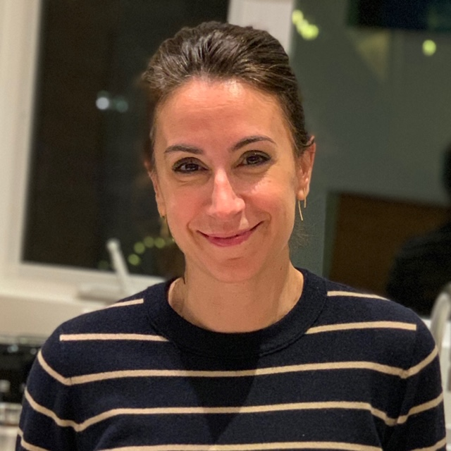
Welcome, we’re glad you’re here!
Kirsten Jewett
PTA Staff Liaison
kejewett@seattleschools.org
Kristen Eckert,
VR Vice Principal kmeckert@seattleschools.org
Ed Roos,
VR Principal
ejroos@seattleschools.org
Kathryn Lachenmaier, PTA Co-President, katvannim@gmail.com
Megan Flaherty,
PTA Co-President, megan.tittle@gmail.com
Meghan McGuire,
PTA Vice President, meghanmcguire22@gmail.com
Casey White,
PTA Secretary, caseyannwhite@yahoo.com
Jana Witt,
PTA Treasurer, janawitt@comcast.net
Angie Kennedy,
PTA Assistant Treasurer, angiepkennedy@gmail.com
Cory Na,
OK Coordinator, nasome@gmail.com

Slide 3
What is the Parent Teacher Association or PTA?
What: For more than 120 years, National Parent Teacher Association (National PTA®) has worked toward bettering the lives of every child in education, health, and safety.
Who: Network of millions of families, students, teachers, administrators, and business and community leaders
How: Through advocacy, as well as family and community education, National PTA has established programs and called for legislation that improves our children’s lives, such as:
Creation of Kindergarten classes
Child labor laws
Public health service
Hot and healthy lunch programs
Juvenile justice system
Mandatory immunization
Arts in Education
School Safety
https://www.pta.org/home/About-National-Parent-Teacher-Association/Mission-Values/National-PTA-History

Slide 4
But why join the PTA at View Ridge Elementary?
The PTA is an important part of View Ridge, especially this year.
Made up of the Executive Board (think: president, treasurer, etc.), parents (you!) and teachers, the PTA connects ALL of us at View Ridge.
Did you know that the money we raise through our PTA helps to support programs such as our librarian, counselor, and weekend food backpacks?
Your PTA membership helps give money and supplies directly to View Ridge teachers and students.
Membership is set at $17 per individual
Joining the PTA supports your child’s school!

Slide 5
I’m already swamped, do I have to volunteer if I join the PTA?
No, you don’t! ☺ What we most want is your input, feedback, and guidance in supporting our community, especially this year.
You can share your thoughts via answering upcoming surveys, attending upcoming PTA meetings, emailing your PTA team, and emailing school staff (child’s teacher, counselor, Mr. Roos).
BUT, if you’re interested in volunteering….

Slide 6
How do I volunteer?
Who: All View Ridge Families!
What: We have many big and small jobs! This year will look a bit different, but we’ll still need volunteers!
Why: View Ridge thrives on all its parent volunteers! The success of our great school depends on all of us.
How: If you have not already signed up, please look over the pink Volunteer Sign Up Sheet included in the First Day Packet and find something that’s right for you.
When: Please return forms as soon as possible.
Please complete district volunteer training, link is here: https://www.seattleschools.org/families_communities/volunteer/volunteer_application_process
Questions? Please contact our fabulous Volunteer Coordinator Sunshine Feldman, sunshinefeldman@live.com

Slide 7
Board and Committees at VRE
Communications
OtterKnow, Facebook, Room Parents, Website, Tech
Equity Committee
Family Support Committee
Legislative Liaison
Special Education Liaison
Volunteer Coordinator
Otter FUNd (our fundraiser)
Yearbook Committee
School Pictures (moved to spring)
Staff Appreciation & Hospitality
VRE Gear
Positions on pause this year:
Enrichment (afterschool programs)
Otter Food Packs
Assemblies
Reimagined Events for this year:
Boo Ridge; Pre-Loved Book Sale & Pancake Breakfast; Science & Engineering Night; Ice Cream Social

Slide 8
Great, so how do I become a member?
Register HERE today:
https://www.memberplanet.com/packetview/viewridgepta6-15-345/membership
If you need a scholarship, please contact Kathryn Lachenmaier, katvannim@gmail.com

Slide 9
Stay Connected
View Ridge PTA website
www.viewridegeschool.org
Updated regularly
View Ridge School website
www.viewridgees.seattleschools.org
View Ridge Otter Know, OK
Comes out on Tuesdays, with updates on Fridays as needed via email
Email Cory Na, nasome@gmail.com to join OK distribution list
PTA General Meetings
Tuesday, 7:00 – 8:30pm, zoom:
October 13, February 9, May 11
PTA Board Meetings
Tuesday, 7:00 – 9:00pm, zoom:
October 13; November 10; December 8; January 12; March 9; April 20, June 8
Principal Coffees: Tuesdays at 12pm (via Teams)
Roos Report, every Friday via email
Buddy Program
If you’re new to View Ridge and you would like to be assigned a buddy or if you would like to be a buddy family, please email Sunshine Feldman, sunshinefeldman@live.com, and include parent’s and children’s names, incoming grade, gender, best phone number, and email address.

Slide 10
Fundraise While You Shop
Did you know you can add View Ridge PTA to your Smile Amazon account and raise funds for the school with your purchases?
You can also raise funds with purchases at Safeway, Fred Meyer, and Bartells.
Please see our website and go to the tab “Fundraising” on how to add VREPTA to your account for raising funds while you shop.

Slide 11
Family Support
Please contact our PTA Family Support Volunteer Chair Genny Costin (gennycostin@gmail.com) or school counselor Joyce Cho (jecho@seattleschools.org) if you have a need for assistance or know someone who does.
If you’d like to volunteer to help, click on the “Volunteering” section of the website. We need you!
Our Family Support Committee provides the following:
School Supplies: Provides school supplies/backpacks to any student in need.
Coat Drive: Runs a coat drive in November to gather coats for our sister school.
Giving Tree: Provides gifts and books for school families during the winter holidays. Families are referred through the staff or by parents or can self-nominate or request help by contacting the school counselor, Joyce Cho. Families within the school choose gift tags, purchase and wrap gifts anonymously, and return these to the school office. Stay tuned for plans for this year!
Scholarships: Scholarships for school activities (including after school enrichment classes when in session) are available throughout the year.
Hunger Intervention Program: These are normally scheduled and supplied weekend food backpacks for students in need. The district is providing backpack meals at food sites located at Eckstein Middle School and Nathan Hale High School until further notice.

Slide 12
Go Otters!
Kirsten Jewett
PTA Staff Liaison
kejewett@seattleschools.org
Kristen Eckert,
VR Vice Principal kmeckert@seattleschools.org
Ed Roos,
VR Principal
ejroos@seattleschools.org
Kathryn Lachenmaier, PTA Co-President, katvannim@gmail.com
Megan Flaherty,
PTA Co-President, megan.tittle@gmail.com
Meghan McGuire,
PTA Vice President, meghanmcguire22@gmail.com
Casey White,
PTA Secretary, caseyannwhite@yahoo.com
Jana Witt,
PTA Treasurer, janawitt@comcast.net
Angie Kennedy,
PTA Assistant Treasurer, angiepkennedy@gmail.com
Cory Na,
OK Coordinator, nasome@gmail.com

Slide 13
Any questions?
Current challenges we are hearing from our community:
Technology
School grounds clean up (gardening; garbage; etc.)—stay tuned for a volunteer work party late September or early October
Grocery card fundraiser
Anything to add?
(you can either unmute or put it into chat;
if we run out of time, please put into chat)
This powerpoint will be on the PTA website shortly

